Slide 1


Using Explainable AI to Assess Machine Learning Models on the Forecasting of Hospital Mortality in COVID-19 Patients
Greg Gipson
Notes:
Explainable AI aims to address the challenge of understanding the decision-making process of black box AI models.

Slide 2
Explainable AI: Benefits of XAI
Transparency -> Increase Trust
Interpretability -> Enhance Decision Making
Data Insight -> Improve Understanding
Notes:
This is particularly important in health care where the consequences of incorrect or biased predictions can have serious implications for patient safety and well-being. Before getting into XAI, let’s construct a simple XGBoost model.

Slide 3

Machine Learning Model

Slide 4
Data Acquisition and Processing
Data Acquisition -> SyntheaTM synthetic patient data
Initial Dataset -> 100,000 COVID-19 patients
Data Processing -> reduced to admitted patients
Feature Selection -> target: patient mortality
-> various lab results
-> patient characteristics
Final Dataset -> balanced by class
-> focus on patient characteristics
Notes:
For this presentation we will focus on the non-lab features which includes patient characteristics such as need for ventilation, need for isolation, ICU admission, gender, length of stay, BMI, and smoking status.

Slide 5
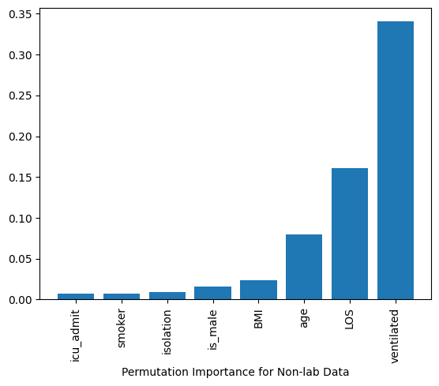
Model Analysis & Evaluation: XGBoost
Metric | Non-lab Data Set
AUC | 97.32%
AUPRC | 97.24%
Accuracy | 92.57%
Recall: True Positive | 94.18%
Specificity: True Negative | 91.00%
Fall Out: False Positive | 9.00%
Miss Rate: False Negative | 5.82%
Precision | 91.07%
Notes:
How can we apply XAI techniques to better understand the model output?

Slide 6
Blackbox explainers
Notes:
"Blackbox explainers" are techniques to provide insights into the decisions made by complex and opaque machine learning or AI models
They aim to shed light on the inner workings of these models by analyzing their outputs and providing explanations or interpretations of why a particular decision was made.

Slide 7
Explainable AI: Blackbox Explainers
SHAP
SHAP (SHapley Additive exPlanations): SHAP values are a method from cooperative game theory, to explain the contribution of each feature to the model's output.
LIME
LIME (Local Interpretable Model-agnostic Explanations): LIME aims to explain individual predictions by highlighting the contribution of each feature to the model's output, offering insights into how the model arrives at its decisions for specific instances.
ELI5
ELI5 (Explain Like I'm 5): ELI5 is a library that provides explanations for machine learning models at various levels of detail, including feature importances, permutation importances, and visualization of decision trees.
Notes:
SHAP can generate a number of different analytics, but two of the most compelling ones are the force plot and the waterfall plot.

Slide 8
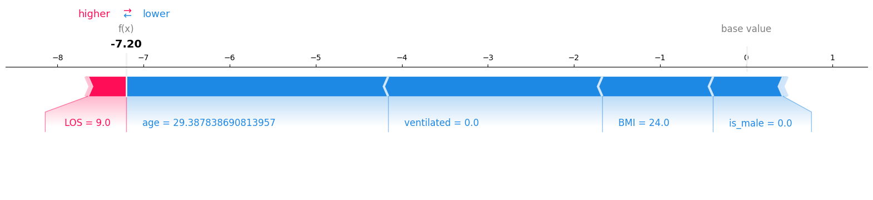
Explainable AI with SHAP: Force Plot
Example of survival in local interpretation

Slide 9
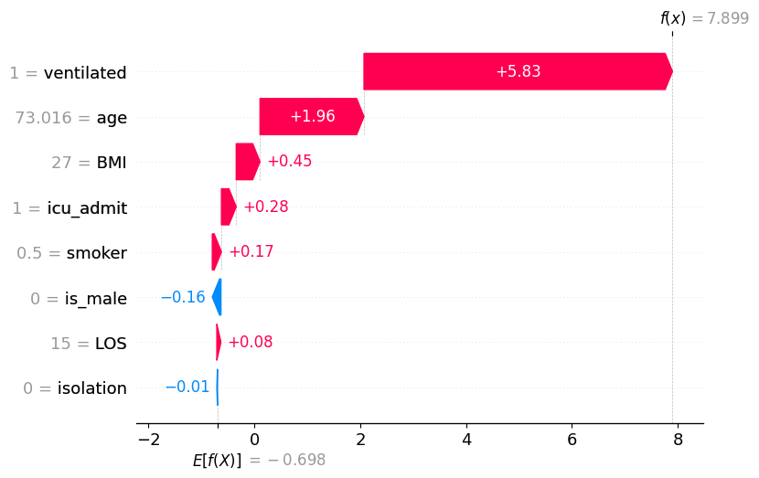
Explainable AI with SHAP: Waterfall Plot
Example of death in local interpretation
Notes:
Now let’s look at LIME, which in addition to feature importance, can generate significant detail around prediction interpretation.

Slide 10
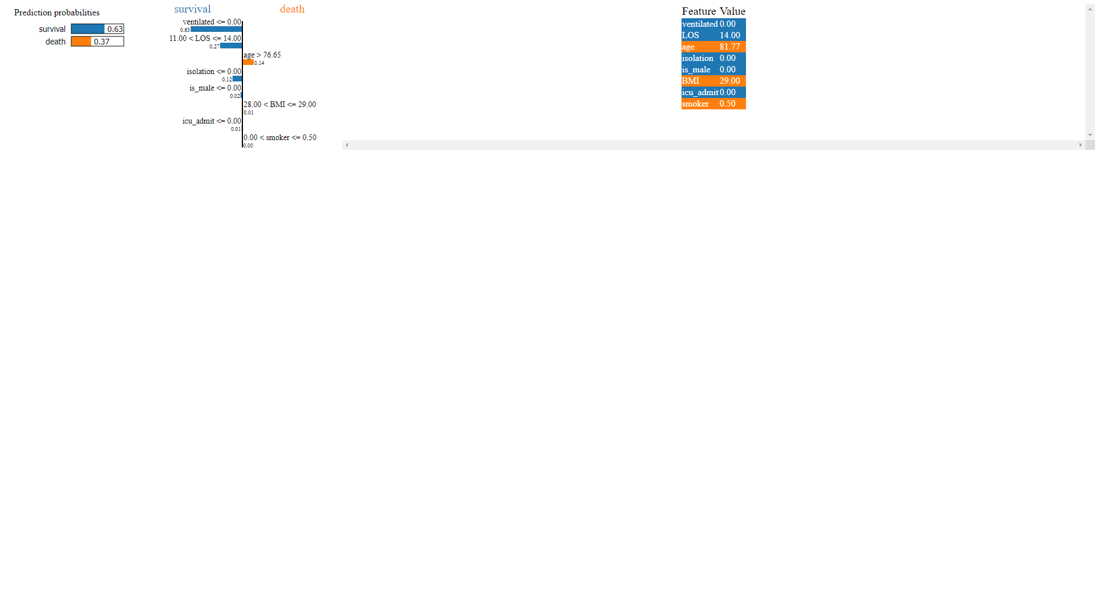
Explainable AI with LIME: Prediction Interpretation
Notes:
The left-most bar plot shows the prediction probabilities, which can be treated as the model's confidence level in making the prediction, in this case a 63% change of survival. The second visualization provides maximum explainability for each of the features. The third visualization shows the features highlighted in orange as contributing toward death, while features highlighted in blue are contributing toward survival.

Slide 11
Explainable AI with ELI5: Textual Explanation
y=died (probability 0.986, score 4.224) top features
Contribution | Feature
+3.855 | ventilated
+1.220 | LOS
+0.607 | icu_admit
+0.376 | age
+0.069 | is_male
+0.008 | <BIAS>
-0.034 | isolation
-0.203 | smoker
-1.674 | BMI
Notes:
We can see that the model predicts a 98.6% probability of death in this case with ventilation, LOS, and ICU admission being the primary contributors to this prediction.
Where does this research lead us?

Slide 12
Future research

Slide 13
Future Research
Enhance our machine learning model
Train and test on real-world data
Hyperparameter tuning
Train and test other Classifier models
Analyze the dataset using Glassbox models
Explainable Boosting Machine (EBM)
Decision Trees
Create Blackbox models such as PCA and neural network
Examine these models using XAI
InterpretML – PCA
Captum – neural network
Compare and contrast performance relative to the XGBoost model
Notes:
"Glassbox models" allow humans to better understand how the model arrives at its predictions through greater visibility into the inner workings of the model.
With these approaches, researchers can seek to improve transparency and interpretability of their models to ultimately increase acceptance and trust of their work.

